Slide 1
IMDB Web Scraping Project: Top 10 TV/Movies and Bottom 10 Movies Show
By: Alan “Al” Lin
3:00PM
3/14/2011

Slide 2
Main Purpose
Which movie(s) have (has) the highest rating?
Which movie(s) have (has) the lowest rating?
How many votes for these top or bottom movies or TV shows?

Slide 3
v
Resource: www.imdb.com

Slide 4


Why IMDB?
IMDB is a movie database that including cast, production crew, personnel and fictional character biographies, plot summaries, trivia, and fan reviews and ratings.

Slide 5

The technology tools that I have been used for this project?

Slide 6
To test it your website works or not

Slide 7
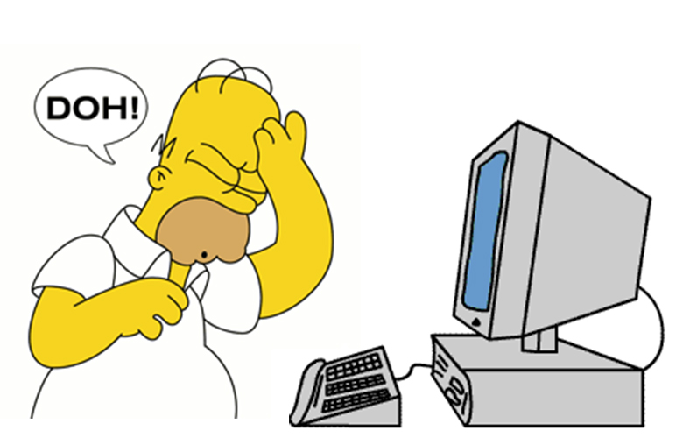
If not?
r.status_code will return
403.
Then, you will get
frustrated like this!

Slide 8
Top 10 Movies with TV shows Ratings

Slide 9
Top 10 Movies Ratings

Slide 10
Lowest Rating (Bottom) 10 Movies or TV Shows

Slide 11
Votes (Top 10 TV Shows)

Slide 12
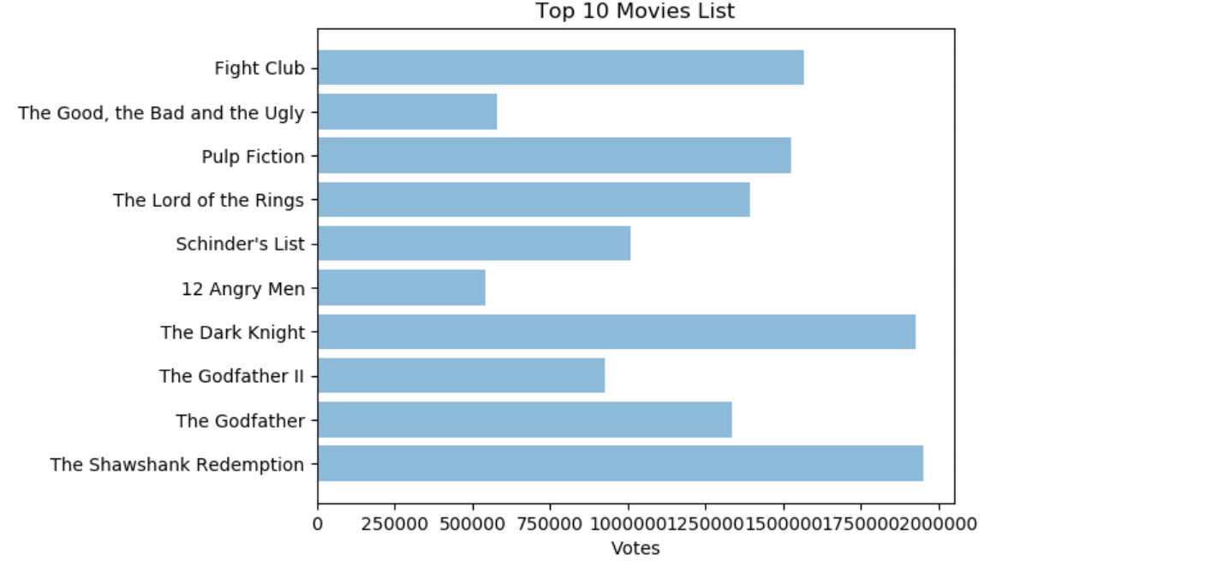
Votes (Top 10 Movies List)

Slide 13
Votes (Bottom 10 Movies/TV Shows)

Slide 14

Conclusion
IMDB is a very interested project, everyone enjoys the TV shows and Movies.
It is a great resource to see which movies (TV shows) are worthy to watch and some are completely wasting time to watch.

